Slide 1
Web Page Protocols
How Do We Get a Web Page?

Slide 2
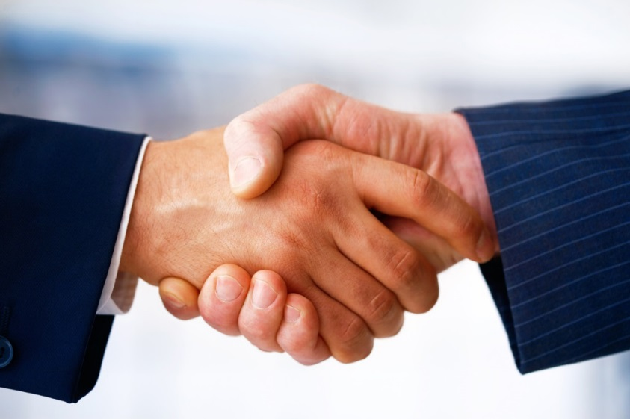
The Web Uses Protocols
Protocols say what to do, and when
Human protocols: handshake
Protocols allow computers to communicate
Made by people, for people
Protocols can climb
the ladder of
abstraction
Notes:
Protocols can sit on top of one another. After a handshake, for example, there are more protocols that let a conversation build to a more meaningful exchange.

Slide 3
The Web Is Part of the Internet
TCP/IP connects computers to create the Internet.
All computers on the Internet have an IP address, e.g. 140.80.12.60. This address is used as the "To:" and "From:" address in TCP/IP.
Some computers on the Internet are web servers, answering requests using the HTTP protocol.
Notes:
Computers on the internet communicate with each other using the TCP/IP protocol, so every computer must have an IP address. The HTTP protocol is used to make a request to a web server.

Slide 4
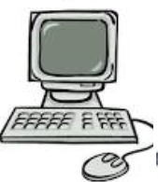
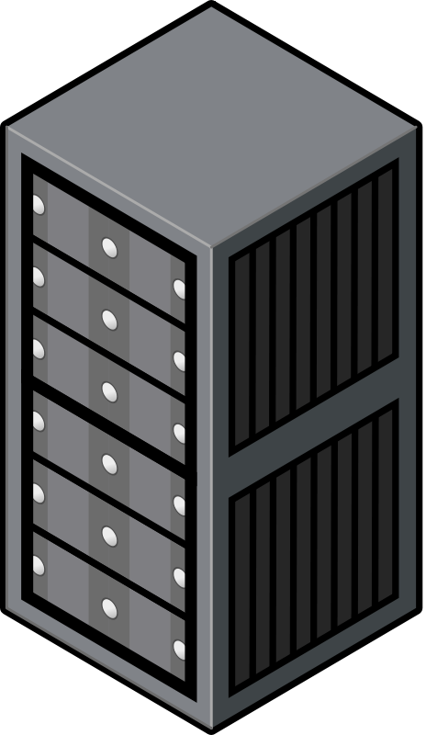
The Web Uses Client-Server Architecture
Clients
All computers have an IP address
Many clients can initiate two-way communication
Common clients: Firefox, Chrome, Safari
Server All servers have an IP address. e.g., pltw.org → 190.93.241.249
Server holds data and web content
Common web server program: Apache
Notes:
All Internet communication is end-to-end: two computers, having a two-way conversation. For the web, one of the computers is the client, and the other is the server. The client is a browser application like Safari, Internet Explorer, Firefox, or Chrome. You type in a URL that contains a domain name, and your client application gets the IP address for the server using the Domain Name System—a group of computers that keep track of the IP address for every domain name. Then your client sends a packet to that IP address by opening a connection to the server and asking for the web page.
NOTE: More information about this is on slide #5.

Slide 5
Acronyms
DNS Domain Name System
URL Universal Resource Locator
Protocols
TCP Transmission Control Protocol
IP Internet Protocol
HTTP Hypertext Transfer Protocol
HTTPS Hypertext Transfer Protocol Secure
Languages
HTML Hypertext Markup Language
CSS Cascading Style Sheet
Notes:
Recite the acronyms and their full names out loud. Doing so creates new neural connections in your brain devoted to saying and thinking these phrases.

Slide 6
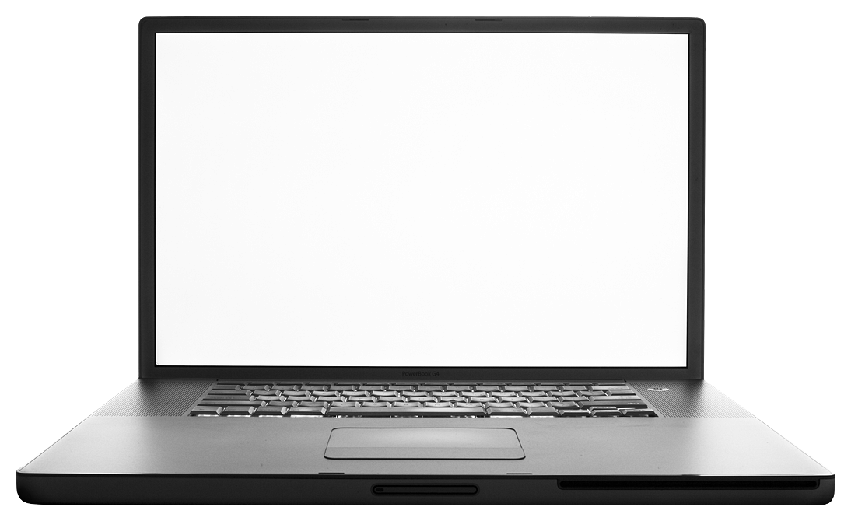
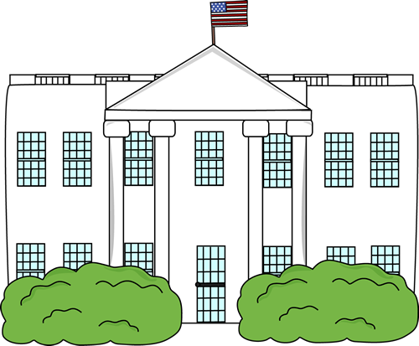
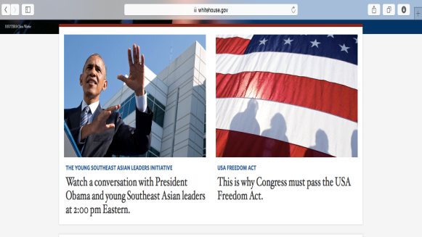
DNS: From website name to IP address
People use URL names to access websites. Computers need IP addresses to communicate via TCP/IP.
2
DNS request: “What is the IP address for whitehouse.gov?”
1
DNS server looks up IP address for whitehouse.gov
DNS response: “Whitehouse.gov is at: 172.224.4.56”
3
4
HTTP request to 172.224.4.56
5
HTTP response contains HTML for whitehouse.gov home page
Notes:
When you type a website name into a web browser, it makes a DNS request. If the URL is not recorded in the computer’s local DNS cache, it sends the name in a request out to the local DNS server. The DNS server maps the name to its IP address by first checking its local cache and then, if not found, querying the network of DNS servers.
Once your web browser has the IP address of the desired website, it can communicate directly with the web server via TCP/IP and HTTP.

Slide 7
Web Content Is HMTL, CSS, JavaScript…
HTML: Marks up meaning of content
CSS: Styles the content
JavaScript: Makes the content interactive
<HTML>
<HEAD>
<TITLE>Great web page</TITLE>
</HEAD>
<BODY>
Some great content
</BODY>
</HTML>
Notes:
Ultimately the goal is to exchange information between client and server. A web server sends content in the form of text. The text has to be embedded inside HTML tags, shown here, for describing the content. On most web pages, the HTML also includes islands of CSS to tell the browser how to render the content and JavaScript for making the content interactive.
But the web content has to get from one machine to another. Any two computers on the Internet can exchange packets with each other. The protocols that let them do that can carry web data or any other data.

Slide 8

Web Uses Protocols to Send Content
IP Header
TCP Header
HTTP Header
HTTP Body
TCP Body
IP Body
Notes:
The body of the HTTP packet, for example, could also carry image data, like this image of Admiral Grace Hopper, who invented the first programming language intended to make computers programmable by more people.

Slide 9
TCP/IP Carries All Internet Content*
IP Header
*Almost
TCP Header
TCP Body
IP Body
Notes:
In this activity we focus on the inner content—the HTTP. It sits inside TCP/IP, which carries 98% of Internet traffic.

